Slide 1

Kesha gokani –EC019 Katiriya Sahil S - EC027

Slide 2
Problem Statement- The main aim of this project is to develop a system that will use the camera of the system, which will detect and recognize face of the person. (using the tool in OpenCV called as the Open Face and python programming language)

Slide 3
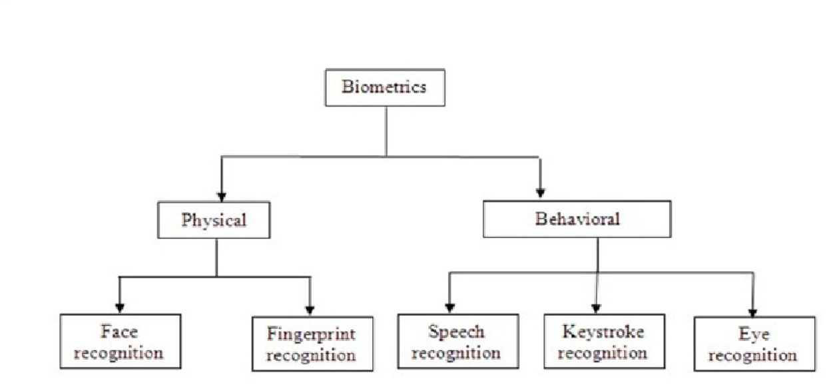
Flowchart – 2( Biometrics)

Slide 4
The three phases of the Project are:
1) Face Detection and Data Gathering
2) Train the Recognizer
3) Face Recognition

Slide 5
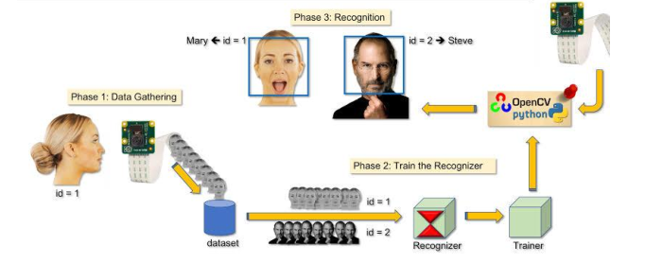
Flow chart

Slide 6
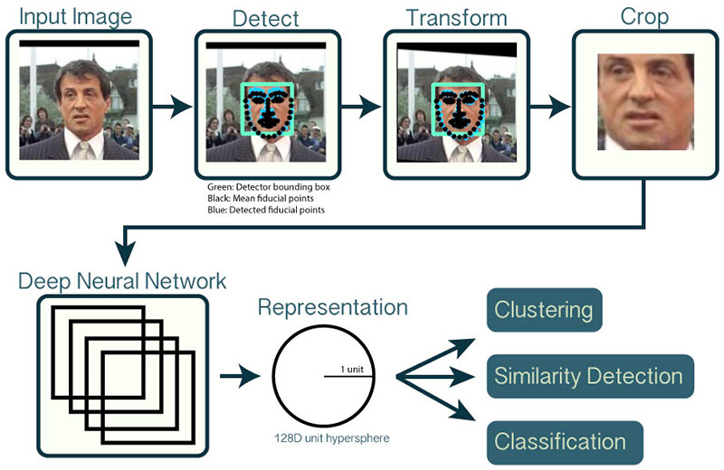
Flowchart – 3 ( FACE DETECTION)

Slide 7
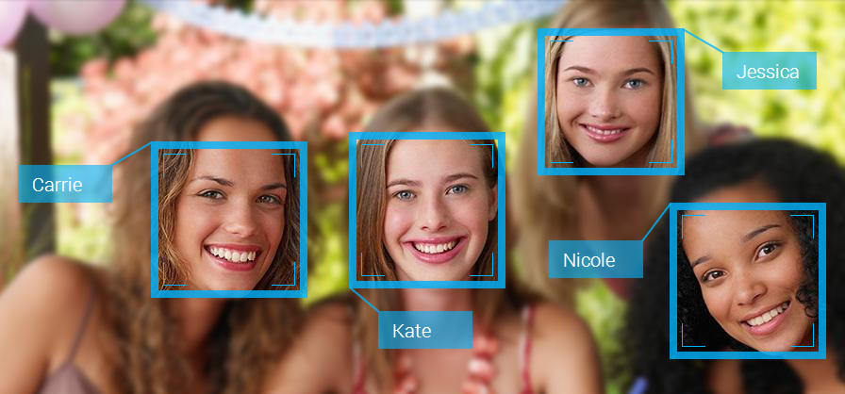
Image

Slide 8
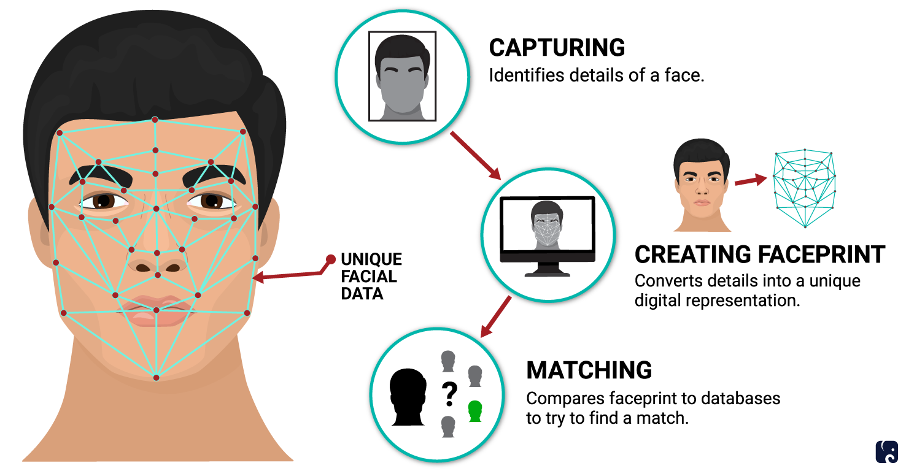
Example ( All phases of Detection)

Slide 9
Advantages
1) Helps to find missing people 2) Safety and Security purpose 3) Reduces the Human intervention or reduces Manpower 4) Makes the shopping efficient 5) Improves photo organization cloud storage through Apple /Google.

Slide 10
